Slide 1
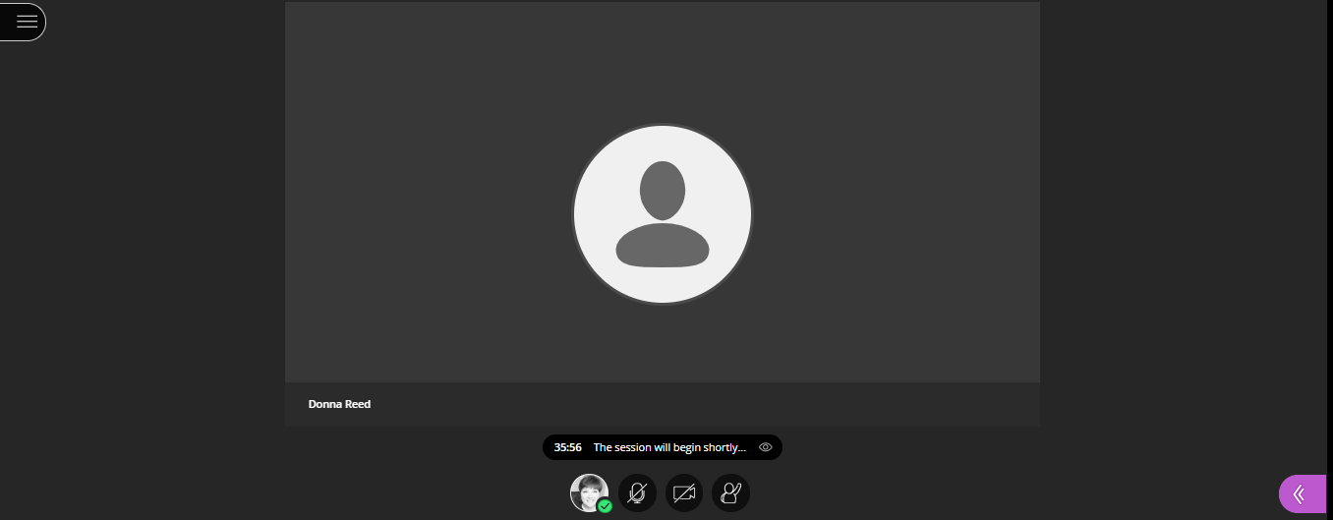
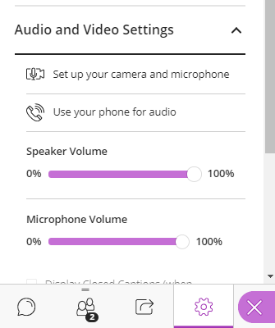
Web Community Manager Amplify Your Ally Score – Google Docs and Slides
The session will begin shortly.
Select to access the
Chat and Audio options.
Audio is available via computer or phone
Microphones have been enabled (please consider muting your line until needed)
Notes:
Name:
AMPLIFY Webinars
Join Session: Join your session up to 15 minutes before it starts.
• Your link:
Join the Blackboard Collaborate session (This link is associated with your account. Don't share with anyone else.)
Invite others to join: Send this guest link to your attendees:
• Guest link:
https://us.bbcollab.com/guest/3dffa391535c4c419004b04eea5a6919
Session dial-in: Call in anonymously. Attendees using this PIN appear as anonymous callers in the session.
• Dial-in:
571-392-7650
• PIN:
7151094082

Slide 2
Web Community Manager Amplify Your Ally Score – Google Docs and Slides
Today’s Presenter: Hannah Kloscak
Notes:
Name:
AMPLIFY Webinars
Join Session: Join your session up to 15 minutes before it starts.
• Your link:
Join the Blackboard Collaborate session (This link is associated with your account. Don't share with anyone else.)
Invite others to join: Send this guest link to your attendees:
• Guest link:
https://us.bbcollab.com/guest/3dffa391535c4c419004b04eea5a6919
Session dial-in: Call in anonymously. Attendees using this PIN appear as anonymous callers in the session.
• Dial-in:
571-392-7650
• PIN:
7151094082

Slide 3
Session Information
Today’s Session Length: Approximately 2 hours.
Session Structure: Presentation with hands-on practice opportunities. You should have your own Google account to fully participate.
Today's session will be conducted using
Blackboard Collaborate
Google Docs
Google Slides
Disclaimer: The content in this presentation was prepared for informational purposes only. The information contained herein is not intended to constitute legal advice and you should consult with your own attorney when developing your online accessibility program and policy. Blackboard assumes no liability in connection to this presentation and any information contained here in.
Notes:
AmplifyAlly@gmail.com / Ampl1fyW3b

Slide 4
Today’s Topics
Review Common Accessibility Issues for Digital Resources
Analyze .docx and .pptx file issues reported by Ally
Demonstrate How to Access Ally’s Instructor Feedback
Evaluate and improve the Ally Score for a
Google DOC saved as a .docx
Google SLIDES Presentation saved as a .pptx
Compare and Contrast Instructor Feedback results

Slide 5
Common Accessibility Issues for Digital Resources
Improper use of headers.
Incorrectly built lists.
Empty links or links without descriptive text.
Missing alternative text tags in images.
Using tables incorrectly.
Uploaded Files/Documents that are not built accessibly.
Color contrast issues.
Readability

Slide 6
What does ALLY scan for in .docx and .pptx?
Severe
Malformed
Major
Images without Alt Text
Contrast issues
Minor
No language set
Does not have the correct language set
Missing headings
Inappropriate heading structure
Headings does not start at 1 or exceeds 6.
Tables without headers
Notes:
https://help.blackboard.com/Web_Community_Manager/Administrator/Reports/Blackboard_Ally_Institution_Report
From Ally Product Manager, Chris Alden - "malformed generally means that the document won't open or is corrupted in some way"

Slide 7
Evaluate and Improve for Web Friendly
Google DOCS
Improper use of headers.
Incorrectly built lists.
Empty links or links without descriptive text.
Missing alternative text tags in images.
Using tables incorrectly.
Color contrast issues.
Google SLIDES
Improper use of headers and slide titles.
Incorrectly built lists.
Empty links or links without descriptive text.
Missing alternative text tags in images.
Using tables incorrectly.
Color contrast issues.

Slide 8
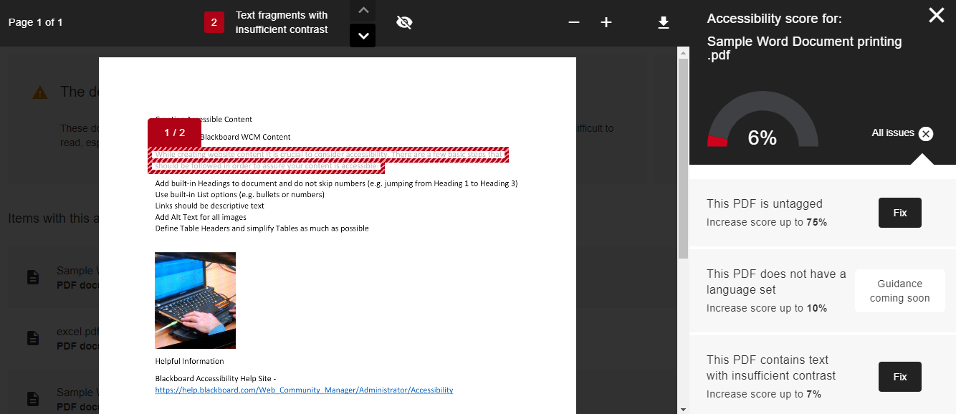
Instructor Feedback for .docx
1
Notes:
Show Ally Section Score, Overview, Choose the Document (Make sure it is a WORD.DOC)

Slide 9
Google DOCS
Sign-in to your Google Account.
Follow the Link provided in the session “Chat”.
Open the Google Doc “Sample File”
Make a Copy of the file.
Rename the file.
Notes:
Open the Word Doc

Slide 10
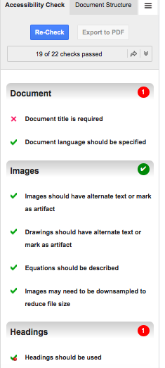
Grackle for Google Docs
Fee based add-on that extends the accessibility of Google Docs by automatically checking all aspects of your document and advising you how to make things better.

Slide 11
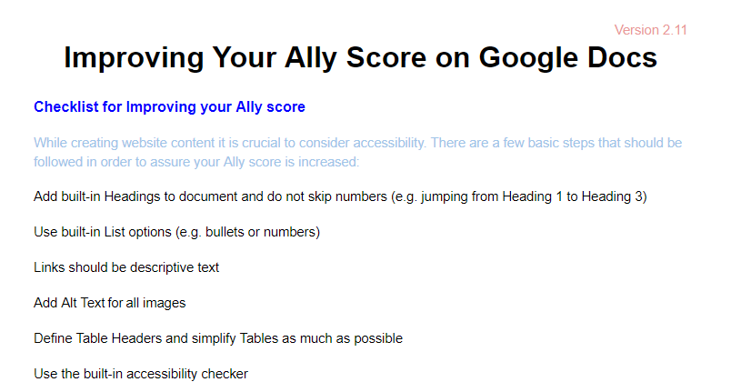
Contrast
Low contrast can make content difficult to read
Consider using a color contrast checker (WebAim.org)
Check contrast for WCAG AA rating (4.5:1 Ratio or higher)
Notes:
Fix : Version & Paragraph to BLACK
Blue: #9fc5e8 (1.8:1
Red: #ff0000 (3.99:1)
Highlight Text and change to “Normal Text”
Then Right Justify
Or
Clear formatting CNTRL+\
Then Right Justify

Slide 12
Heading Structure
Breaks up longer content
Allows screen reader to navigate quickly from heading to heading.
Use ONLY for logical structure NOT sizing, color , or font type.
Only titles and subtitles should be marked as headings, NOT body text.
Use Styles to design your Headings. The format of each may be modified and saved.
CAUTION! Just because it “looks” like a header, doesn’t mean it is.
Notes:
Clear Formatting of Heading 1
Change to DARK GREEN 3

Slide 13
Heading example

Slide 14
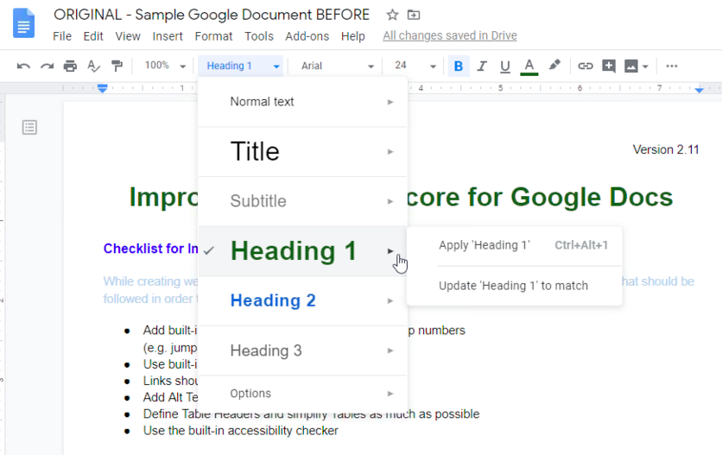
Modify Heading Styles
Notes:
Apply Heading 1
Change color to Dark Green 3
Size to 24
Bold
Center Justify
Update Heading 1
Heading 2:
Change Color to Black
Bold
Update Heading 2
Show all changes were made
Fix Heading 2 to Black and Update

Slide 15
Lists
Use Built-In Feature
Requires Paragraph Return (not line return)
Consider “Numbering” when order matters
Consider “Bullets” when order doesn’t matter
Notes:
If they can not see the list tool, have them check for the “…” more feature on the far right

Slide 16
Links
Links should be clickable descriptive text.
Avoid URL as the text and “click here”.
Making clickable text longer.
By default, links open in a new window.
Notes:
Blackboard Accessibility Help Site
Google Accessibility Help Site

Slide 17
Images and Alternative Text in Docs
Alt Text allows assistive technologies to convert images into words.
Guidelines for Alternative Text:
Images must be in-line with text.
Title should be clear and concise (1 short sentence).
Description should be more detailed.
Avoid using the same text for every image.
Unrelated or decorative images may be marked as (ALT=“”)
Don’t include “image of…” or “picture of…” as part of alt text
If the image is an infographic you should use alt text to provide the information conveyed in the object.
Notes:
Select image and choose “in-line”
Move the image until it is under “increased” and above the “1”
Title: Circle graph comparing Ally scores.
Description: The total score is 92% for the documents that were evaluated.

Slide 18
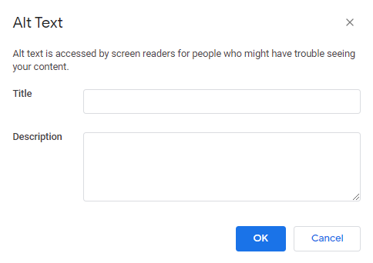
Images Alternative Text
Notes:
Right click on the image or go to the Picture Format Menu bar

Slide 19
Tables
Tables organize information and help you show relationships between things.
Avoid using tables for document layout.
Nested tables, split cells, or merged cells can trip up accessible devices.
Navigate your table using the Tab Key

Slide 20
Download File Type
.docx
Choose .docx
.pdf
Choose .pdf
For Consideration
For Consideration
Grackle
Alternatives to Tables
Grackle
Set Language
Tagging
File Title
Alternatives to Tables
Modify in MSWord
Modify in Adobe
Notes:
If you are working with WCM clients – highlight the fact that they can upload a file originally from Google and it will become a .docx

Slide 21
Download
File
Download
Choose a File Type
.docx
.pdf

Slide 22
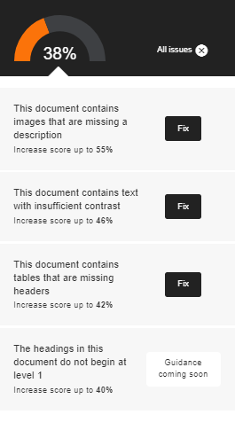
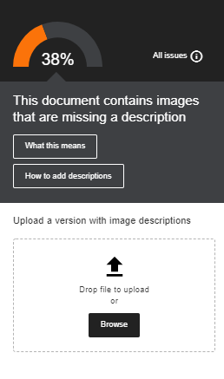
Instructor Feedback – View Your Improved Score
Upload the corrected File
Ally will immediately Score the new document.

Slide 23
Instructor Feedback - .pptx
1
Notes:
Show Ally Section Score, Overview, Choose the Document (Make sure it is a WORD.DOC)

Slide 24
Google Slides
Sign-in to your Google Account.
Follow the Link provided in the session “Chat”.
Open the Google Slides “Sample File”
Make a Copy of the file.
Rename the file.
Notes:
Open the Google Slide Sample

Slide 25
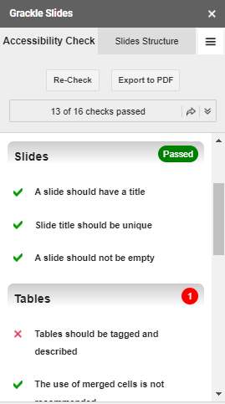
Grackle for Google Slides
Fee based add-on that extends the accessibility of Google Docs by automatically checking all aspects of your document and advising you how to make things better.

Slide 26
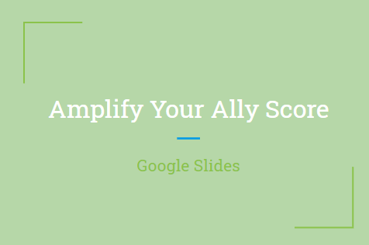
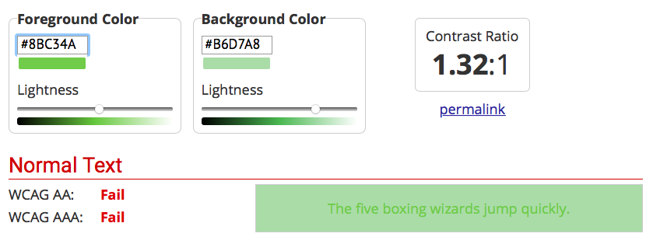
Choose or Create an Accessible Slide Design
Initiate Grackle (if available)
Use Pre-formatted Layouts.
Adjust the Master colors (Color Contrast)
Use a larger font sizes (18pt or larger)
1.32:1 (Text to Background color ratio)
Notes:
Fix Color Contrast Issue : Master Slide background change to #073763 (Dark Blue #3)
Background Icon
Choose Dark Blue #3
Add to Theme
Or
Slide
Edit Master (Select “Master Slide)
Background
Dark Blue #3
CLEAR Formatting for to check the default size.

Slide 27
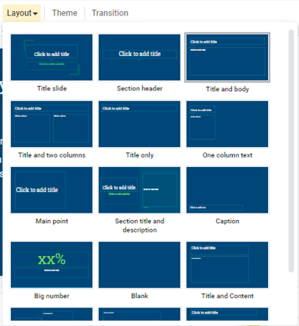
Slide Titles & Layout
Using the Built-in Layout
Unique Slide Title
NOTE: The Ally check enforces a minimum of 1 title for every 7 slides in a .pptx file.
Notes:
Correct the Slide Title

Slide 28
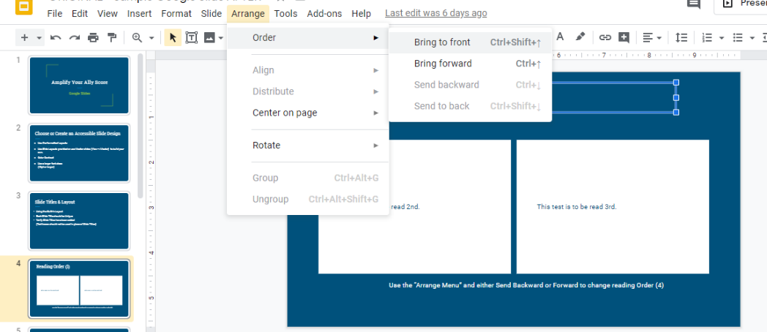
Reading Order
Check the order using your “tab” key.
Send BACKWARD raises the selected item higher in order.
Send FORWARD lowers the selected item in order.
Notes:
Tab to show order
Starting Order 2, 1, 3, 4
FIX: Select Box 1 and Arrange “Send Backward”
Test again to show it starting with 1, 2, 3, 4

Slide 29
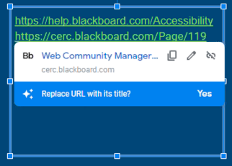
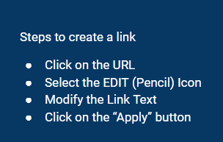
Links & Lists
Links
Descriptive Text (for sharing electronically)
Descriptive Text and Short URL (for sharing electronically and as a printout.)
Lists
Use Built in Paragraph List Tools
Consider using numbers when order matters.
Consider using bullets when order is not important.
Notes:
Blackboard Accessibility Help Site
Amplify Training Series Website

Slide 30
Images and Alternative Text in Slides
Alt Text allows assistive technologies to convert images into words.
Guidelines for Alternative Text:
Title should be clear and concise (1 short sentence).
Description should be more detailed.
Avoid using the same text for every image.
Unrelated or decorative images may be marked as (ALT=“”)
Don’t include “image of…” or “picture of…” as part of alt text
If the image is an infographic you should use alt text to provide the information conveyed in the object.
Notes:
Alt Text:

Slide 31
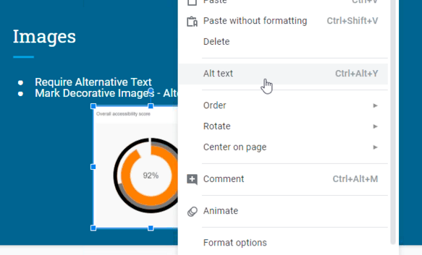
Adding Alternative Text
Notes:
Title:
Description:

Slide 32
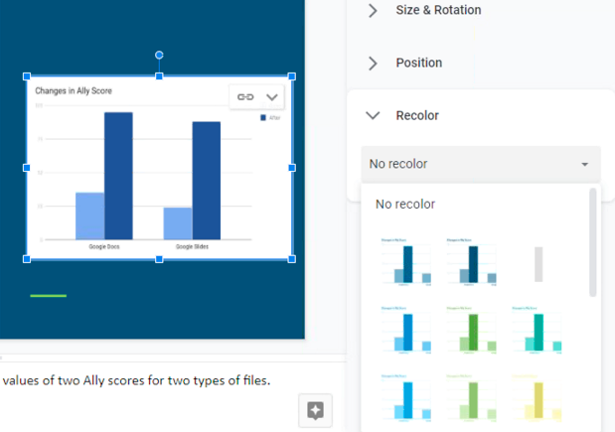
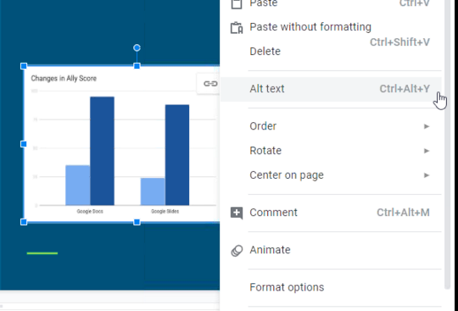
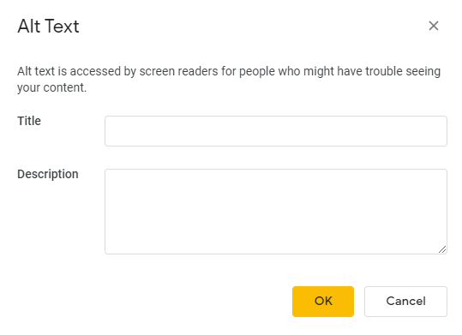
Charts
Review Format Options
Check Color Contrast
Modify using Recolor
Alternative Text
Enter most important info first
Consider including chart type
Be as concise as possible
Notes:
Color change: Light 2
Title: Ally Score Chart
Description: Clustered column chart comparing values of two Ally scores for two types of files.

Slide 33
Tables
Check Color Contrast
Use simple table structure
Add Alternative Text
Tables should not contain
split cells
merged cells
nested tables
Consider using alternative methods/programs to specify column/row header information.

Slide 34
Download Slides as File Type
.pptx
Choose .pptx
.pdf
Choose .pdf
For Consideration
For Consideration
Grackle
Alternatives to Tables
Grackle
Set Language
Tagging
File Title
Alternatives to Tables
Modify in PowerPoint
Modify in Adobe
Notes:
If you are working with WCM clients – highlight the fact that they can upload a file originally from Google and it will become a .docx

Slide 35
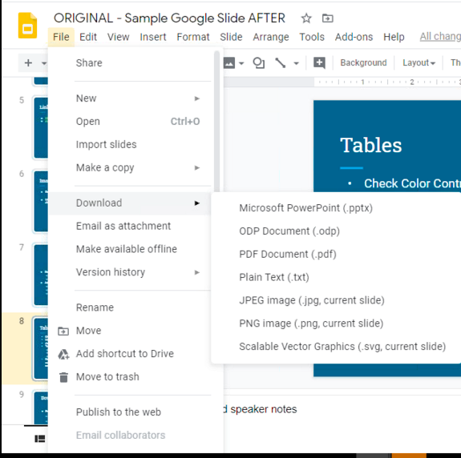
Download
File
Download
Choose a File Type
.pptx
.pdf

Slide 36
Instructor Feedback – View Your Improved Score
Upload the corrected file
Ally will immediately Score the new file.

Slide 37
Evaluate and Improve for Web Friendly
Google DOCS
Improper use of headers.
Incorrectly built lists.
Empty links or links without descriptive text.
Missing alternative text tags in images.
Using tables incorrectly.
Color contrast issues.
Google SLIDES
Improper use of headers and slide titles.
Incorrectly built lists.
Empty links or links without descriptive text.
Missing alternative text tags in images.
Using tables incorrectly.
Color contrast issues.

Slide 38
Amplified Series Information
https://cerc.blackboard.com/amplify

Slide 39
Thank you for attending today’s Amplify Series Session.

